Slide 1
Testing and Quality Analysis of commons-imaging Project
Software Dependability
Prof. Dario Di Nucci
Nima Mehranfar

Slide 2
Agenda
Introduction
CI/CD Pipeline
Software Quality Analysis
Docker Image Creation
Code Coverage Analysis
Mutation Testing
Performance Testing
Automated Test Generation
Security Analysis

Slide 3
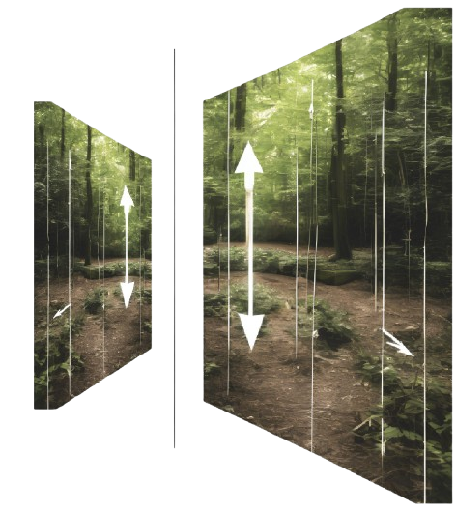


Introduction
What is Apache Commons Imaging?
What it does?

Slide 4
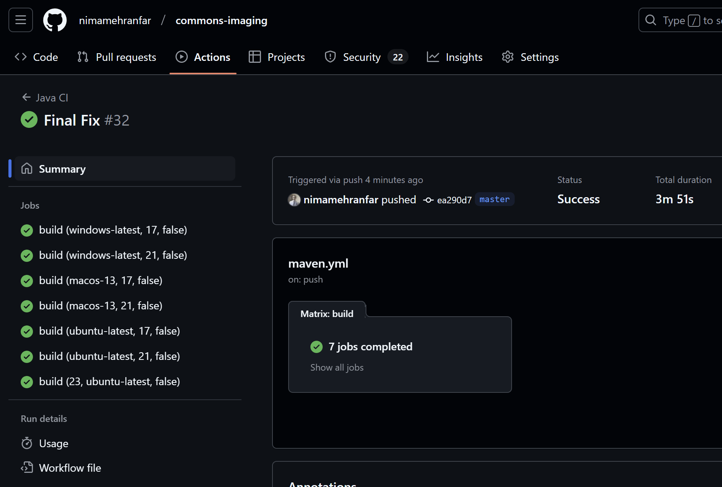
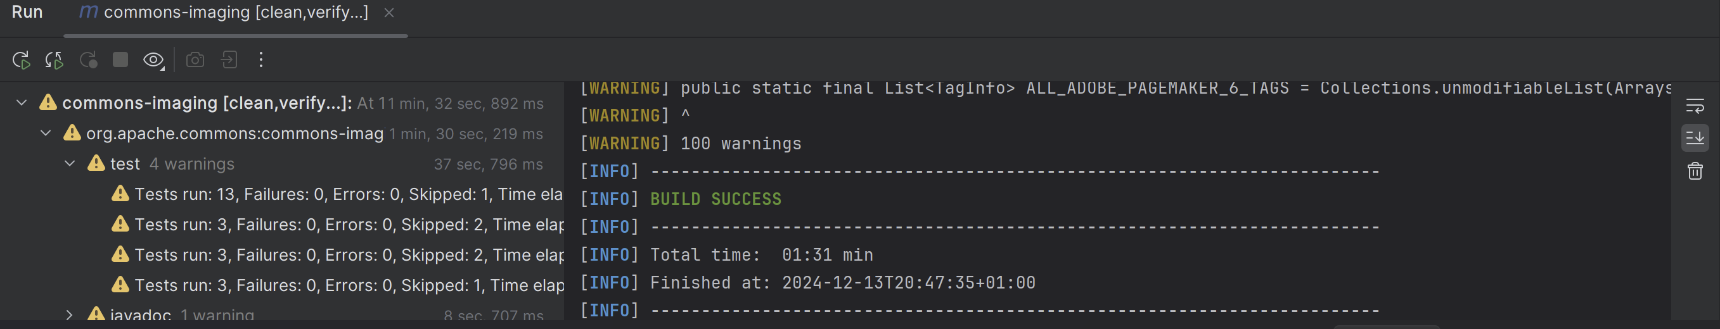
CI/CD Pipeline
CI/CD pipeline configuration utilizing GitHub Actions workflow

Slide 5
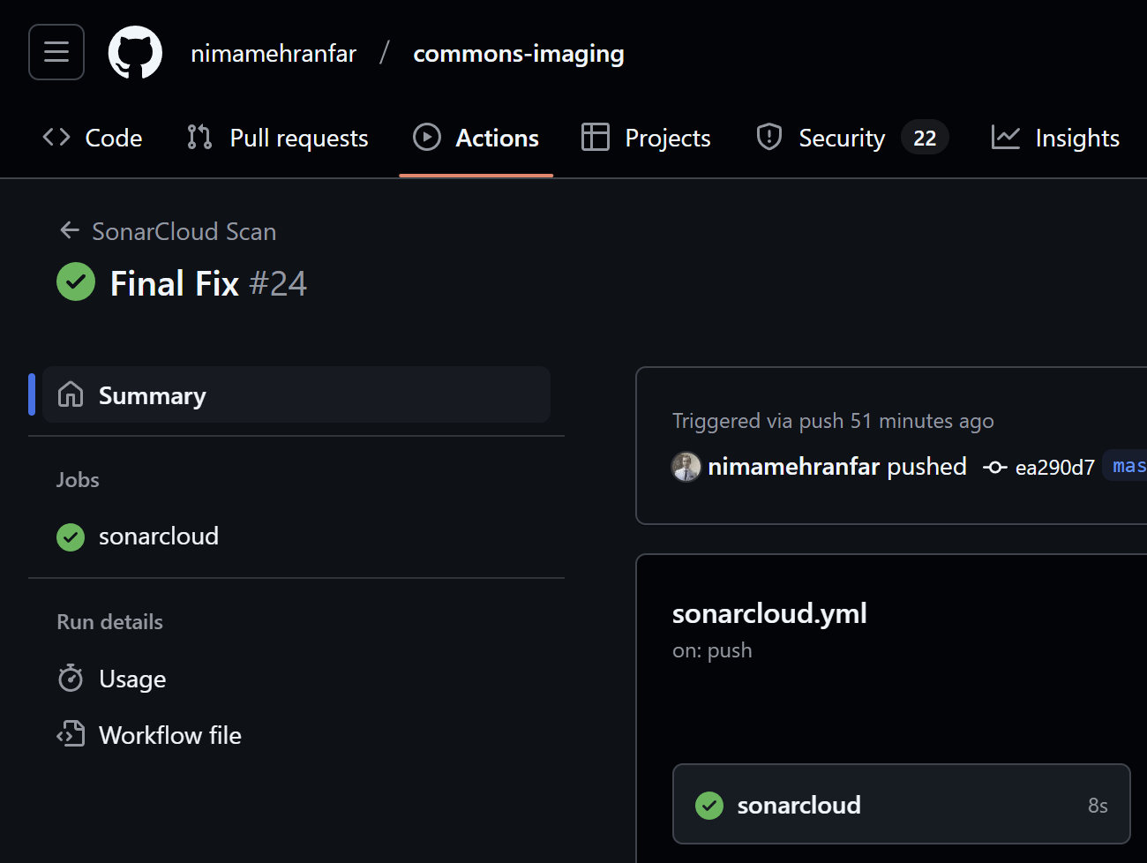
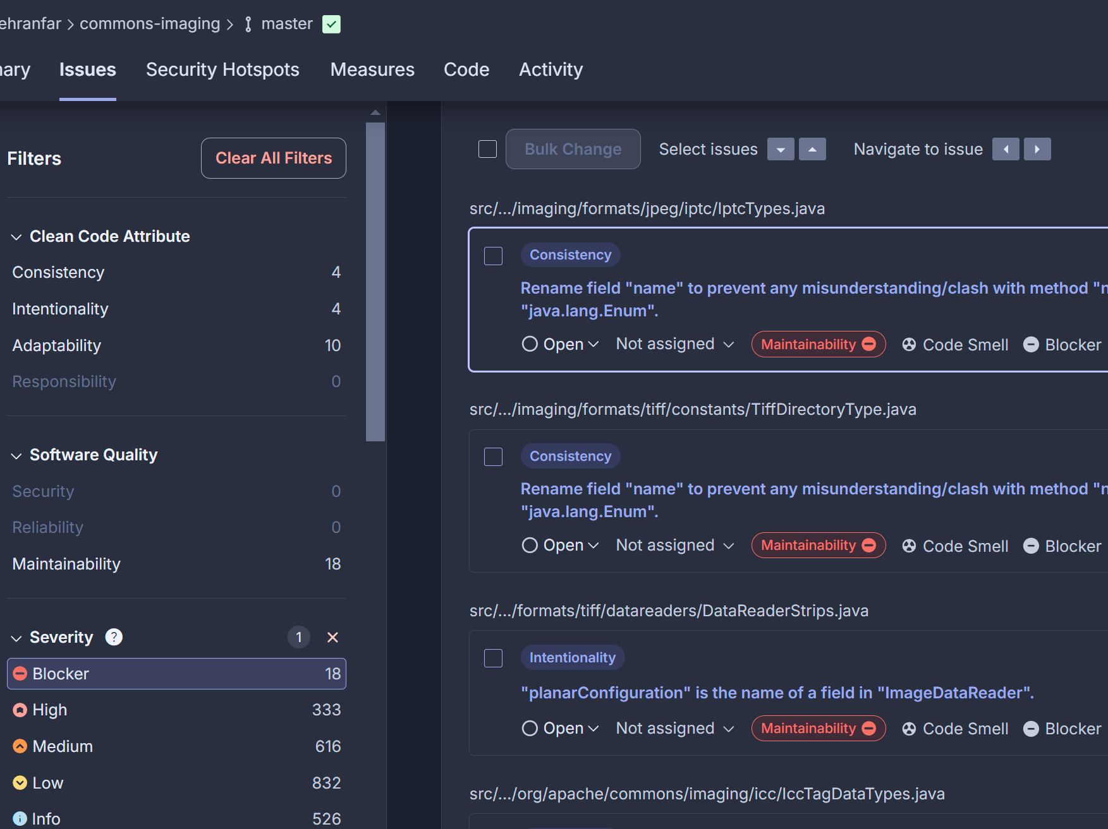
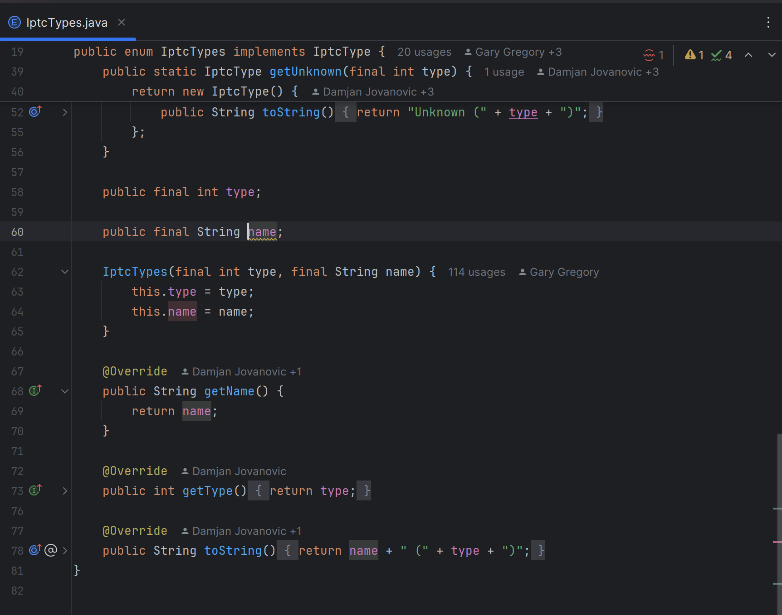
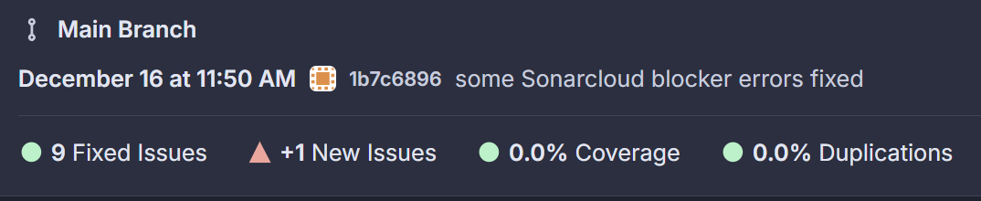
Software Quality Analysis
SonarCloud Setup
Issues Categorization
Refactoring and Reasoning

Slide 6
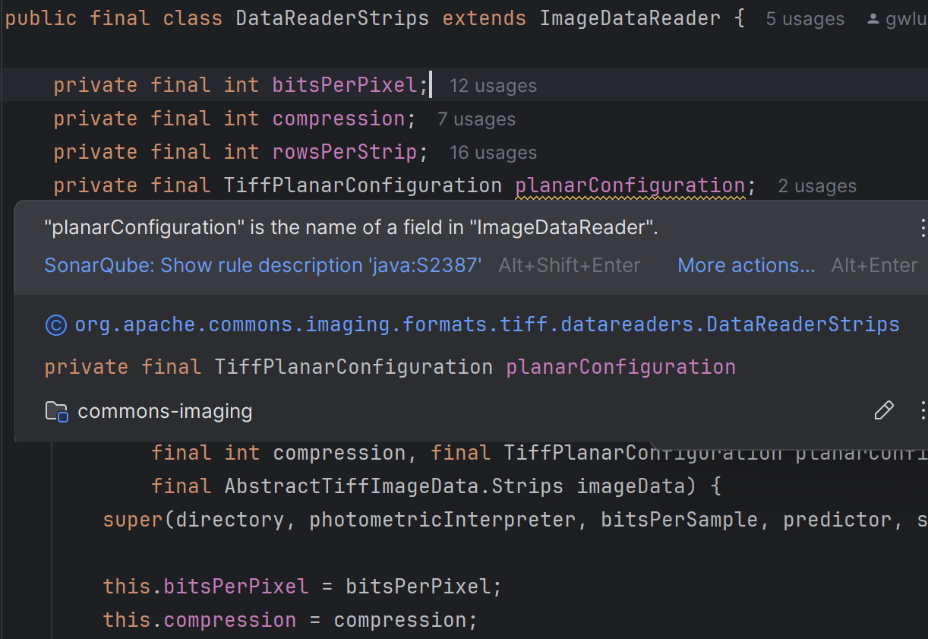
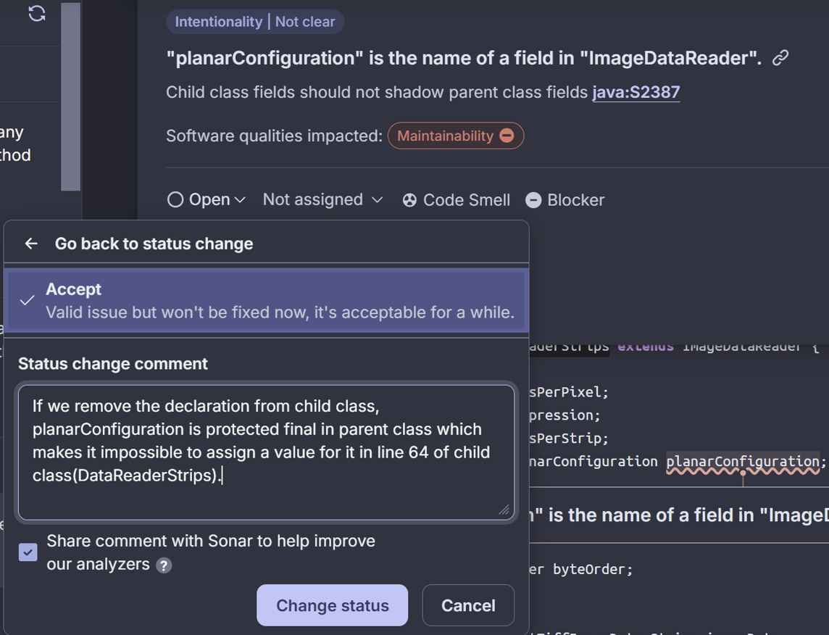
Software Quality Analysis
Example: Parent class field name shadow in child class

Slide 7
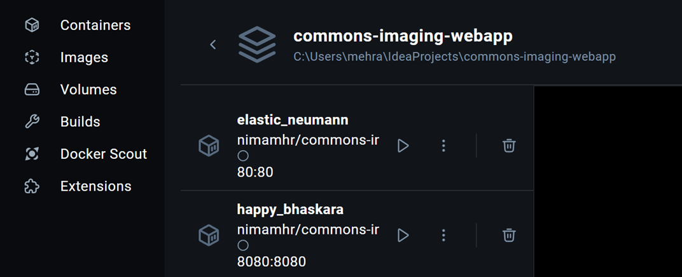
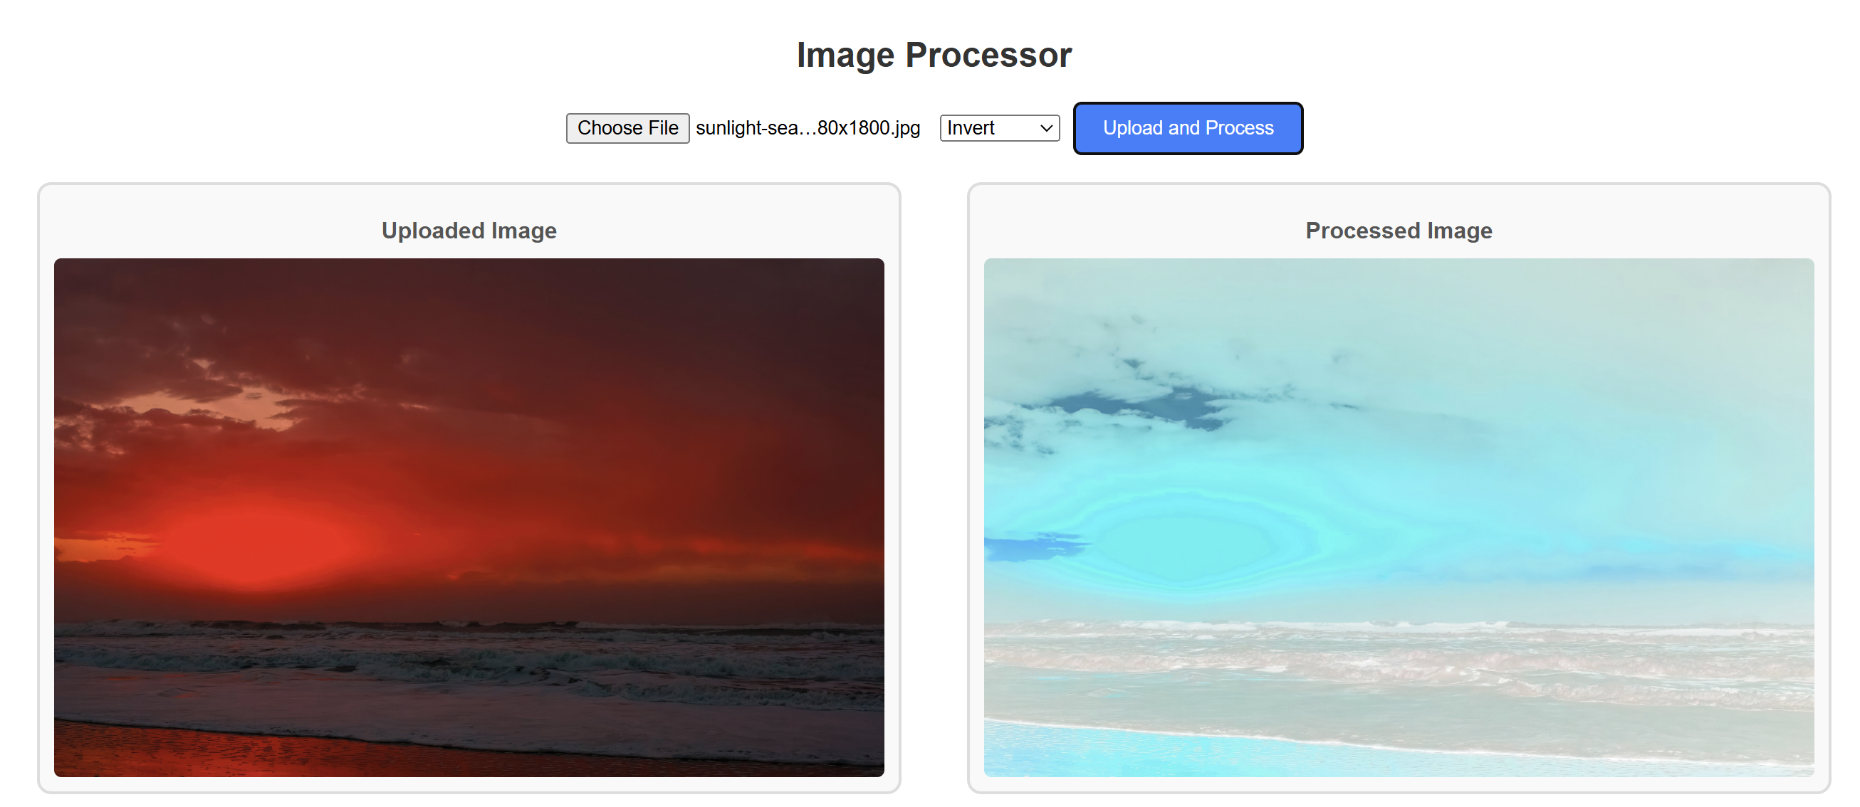
Docker Image Creation
Developing a simple frontend with React.js
Developing a simple backend with Java Spring Boot
Setting-up Docker
Building Docker images of webapp
Configuring Docker Container
Running and Testing Commons-Imaging with webapp

Slide 8
Code Coverage Analysis
Measuring using JaCoCo
Achieving initial coverage
Adding tests for low coverage classes
Achieving improvements for final coverage
Initial | Instructions Coverage (%) | Branches Coverage (%)
Overall | 77% | 64%
Final | Instructions Coverage (%) | Branches Coverage (%)
Overall | 81% | 67%

Slide 9
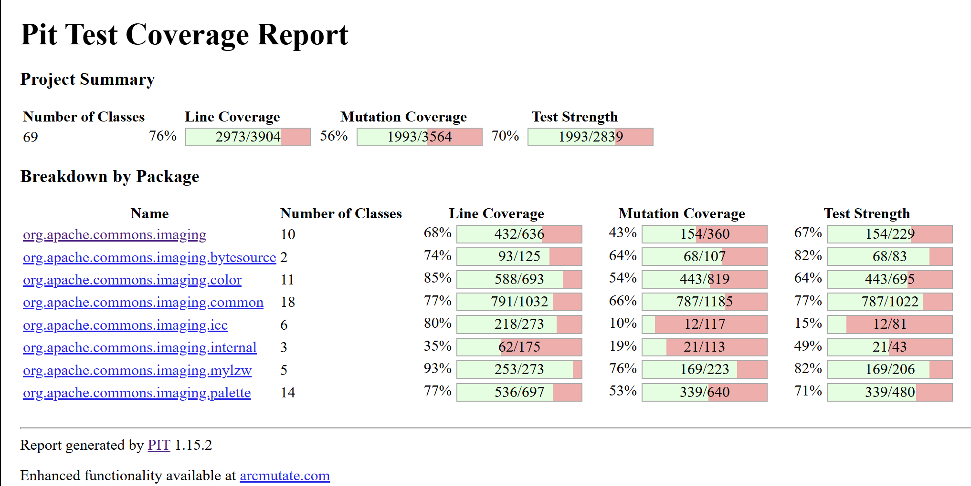
Mutation Testing
Measuring using PiTest
Identifying low coverage classes (ColorTools.java in this case)
Adding tests to improve coverage and maximizing killed mutation and minimizing survived mutation
Achieving results after improvements
Metric | Classes | Line Cov. | Mutation Cov. | Survived Mut. | Test Strength
Overall | 69 | 76% | 56% | 44% | 70%

Slide 10
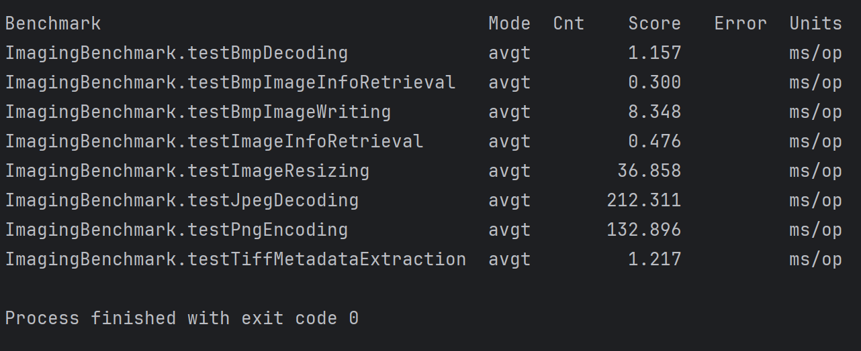
Performance Testing
Guessing most resource greedy methods of project
JMH benchmark setup with sample images
Analyzing results

Slide 11
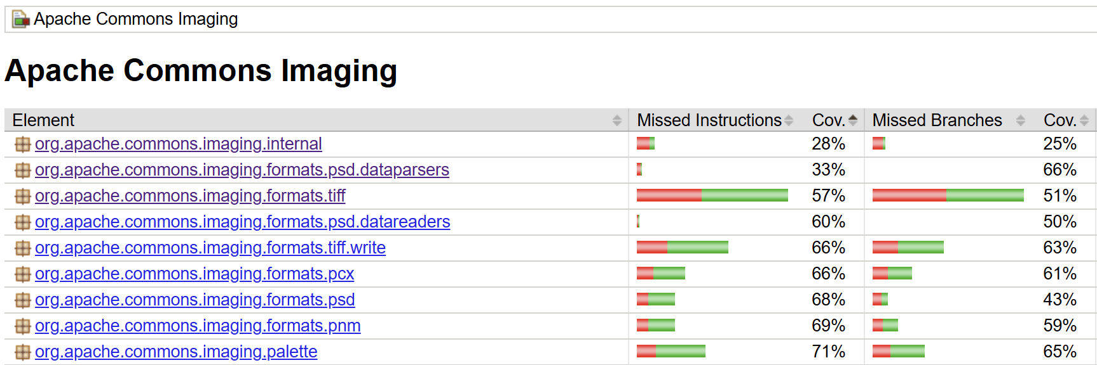
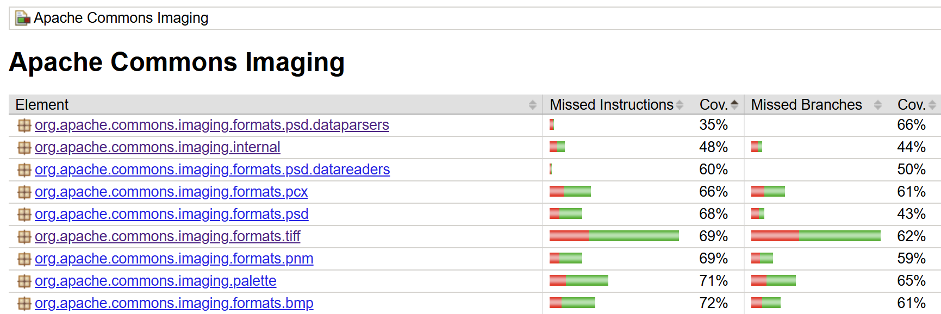
Automated Test Generation
Finding low coverage packages from JaCoCo report
Setting-up Randoop
Generating test cases
Analyzing results and improvements

Slide 12
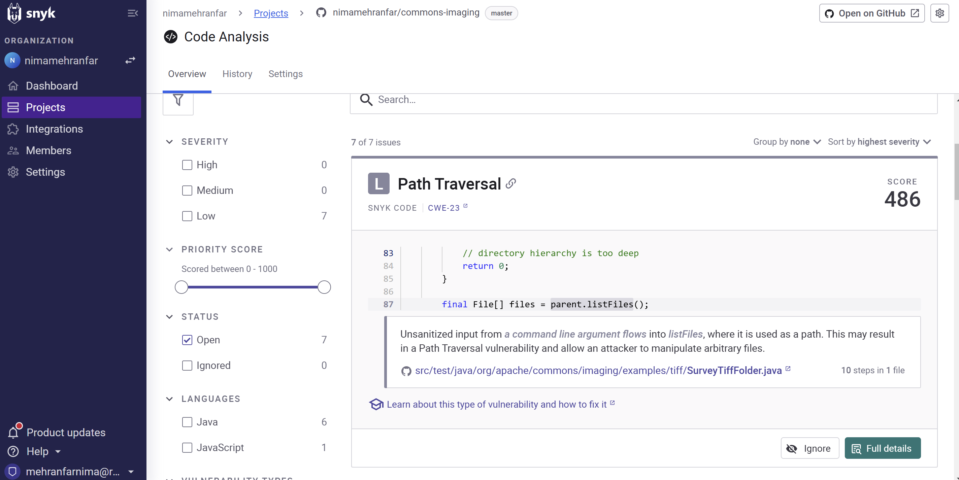
Security Analysis
Setting-up Snyk
Analysing vulnerability report
No dependency vulnerability found
7 ”low” severity issues found related to unsanitized input (All false positive)

Slide 13
Thank You
Nima Mehranfar
n.mehranfar@studenti.unisa.it

